Slide 1
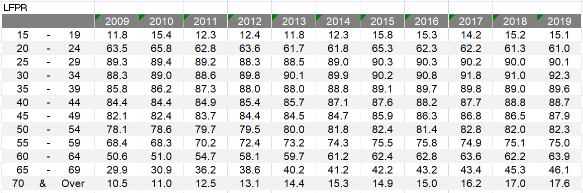
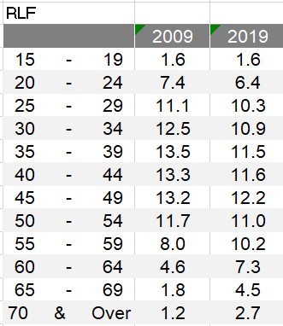
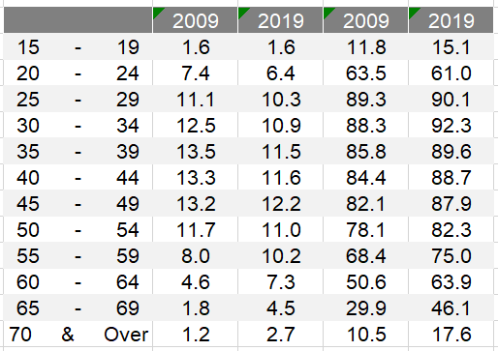

Slide 2
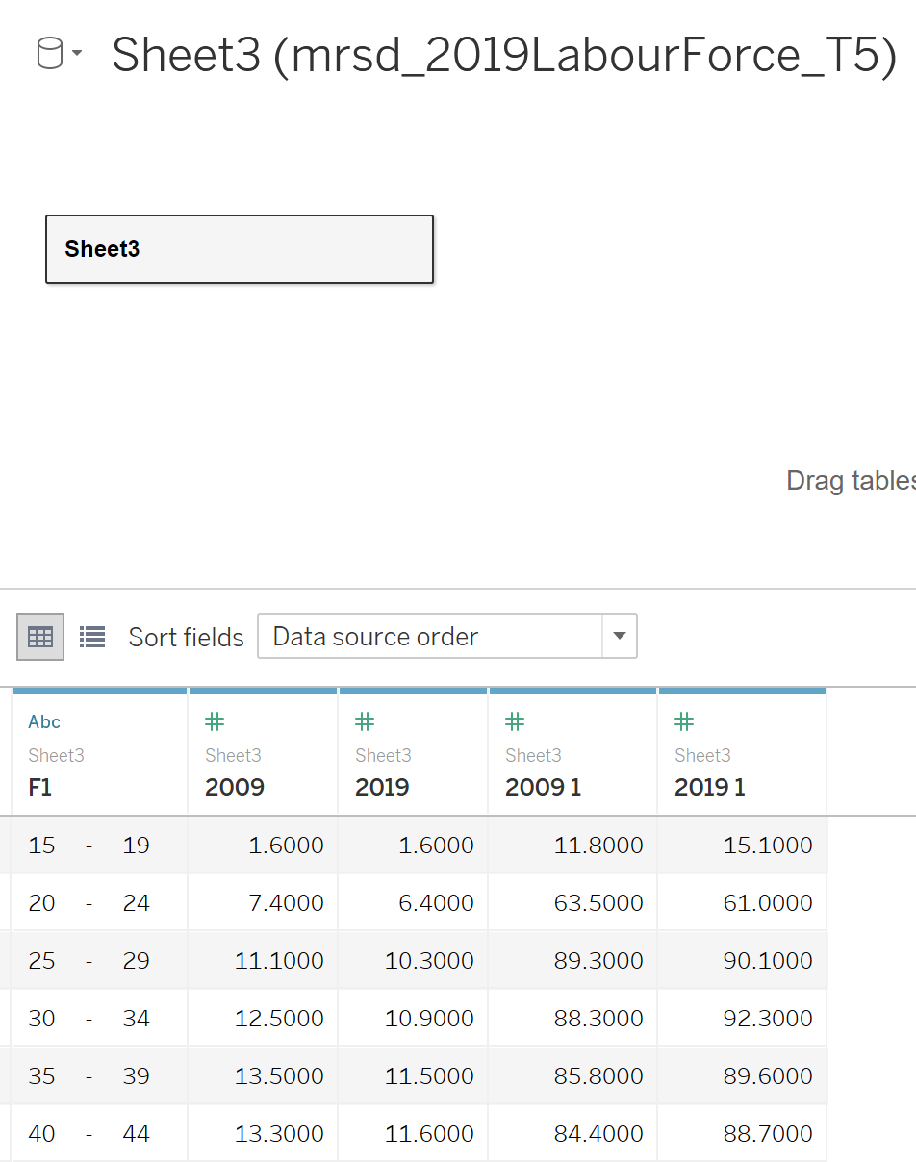
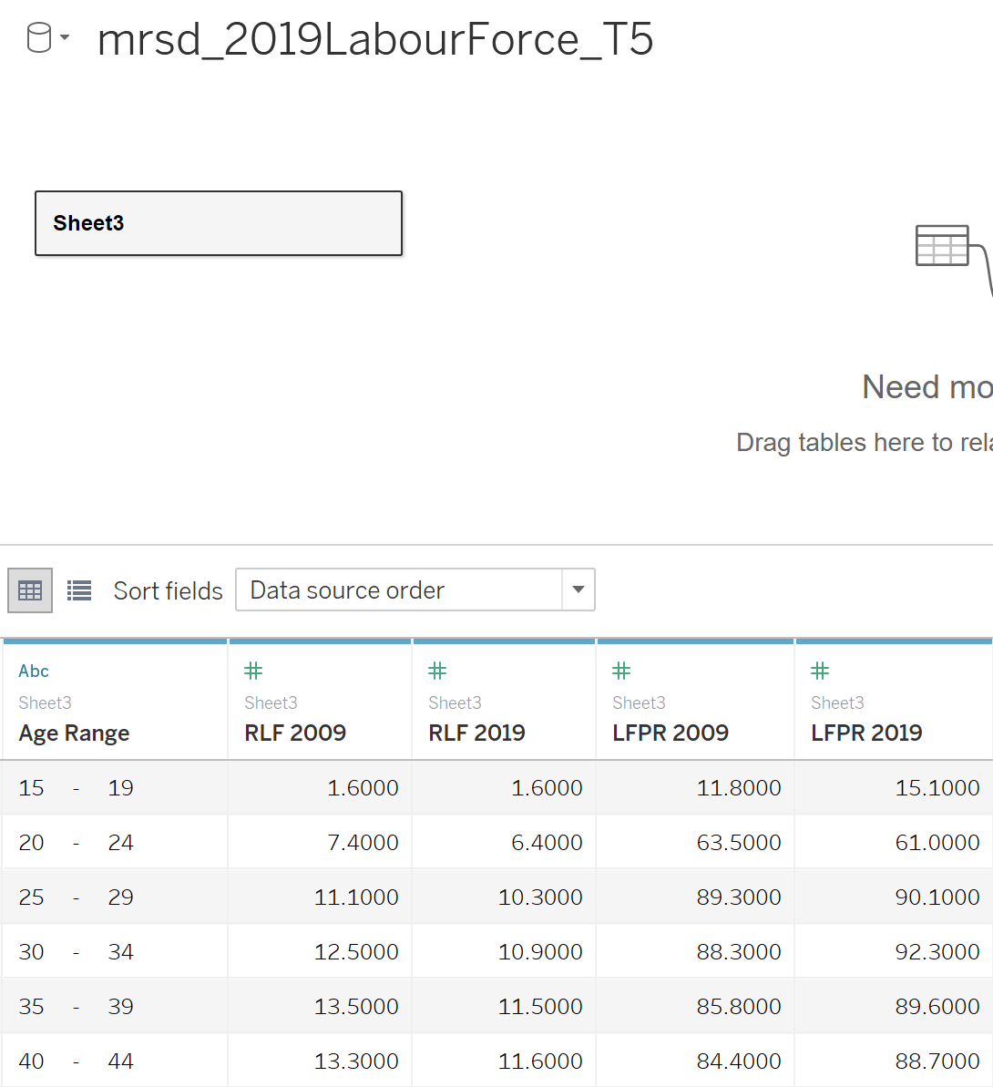

Slide 3
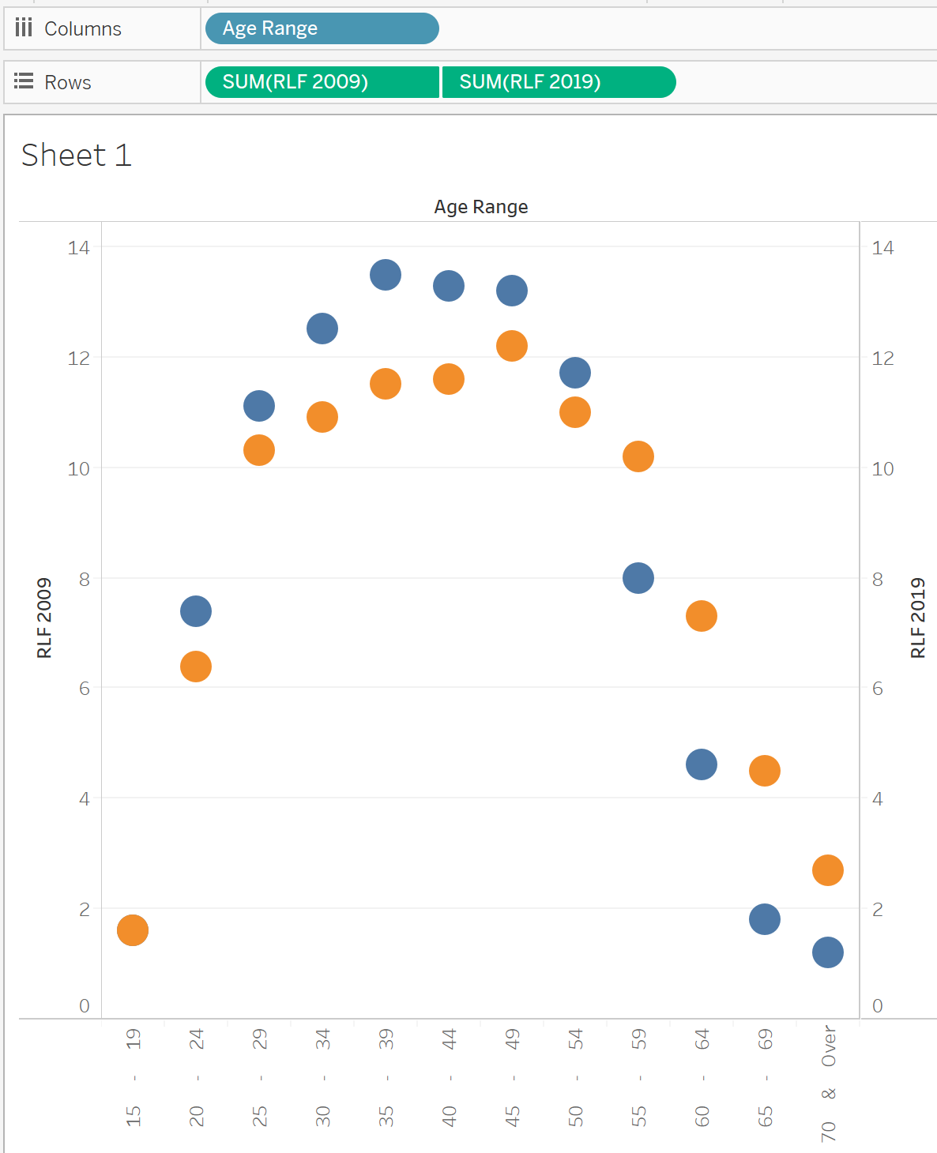
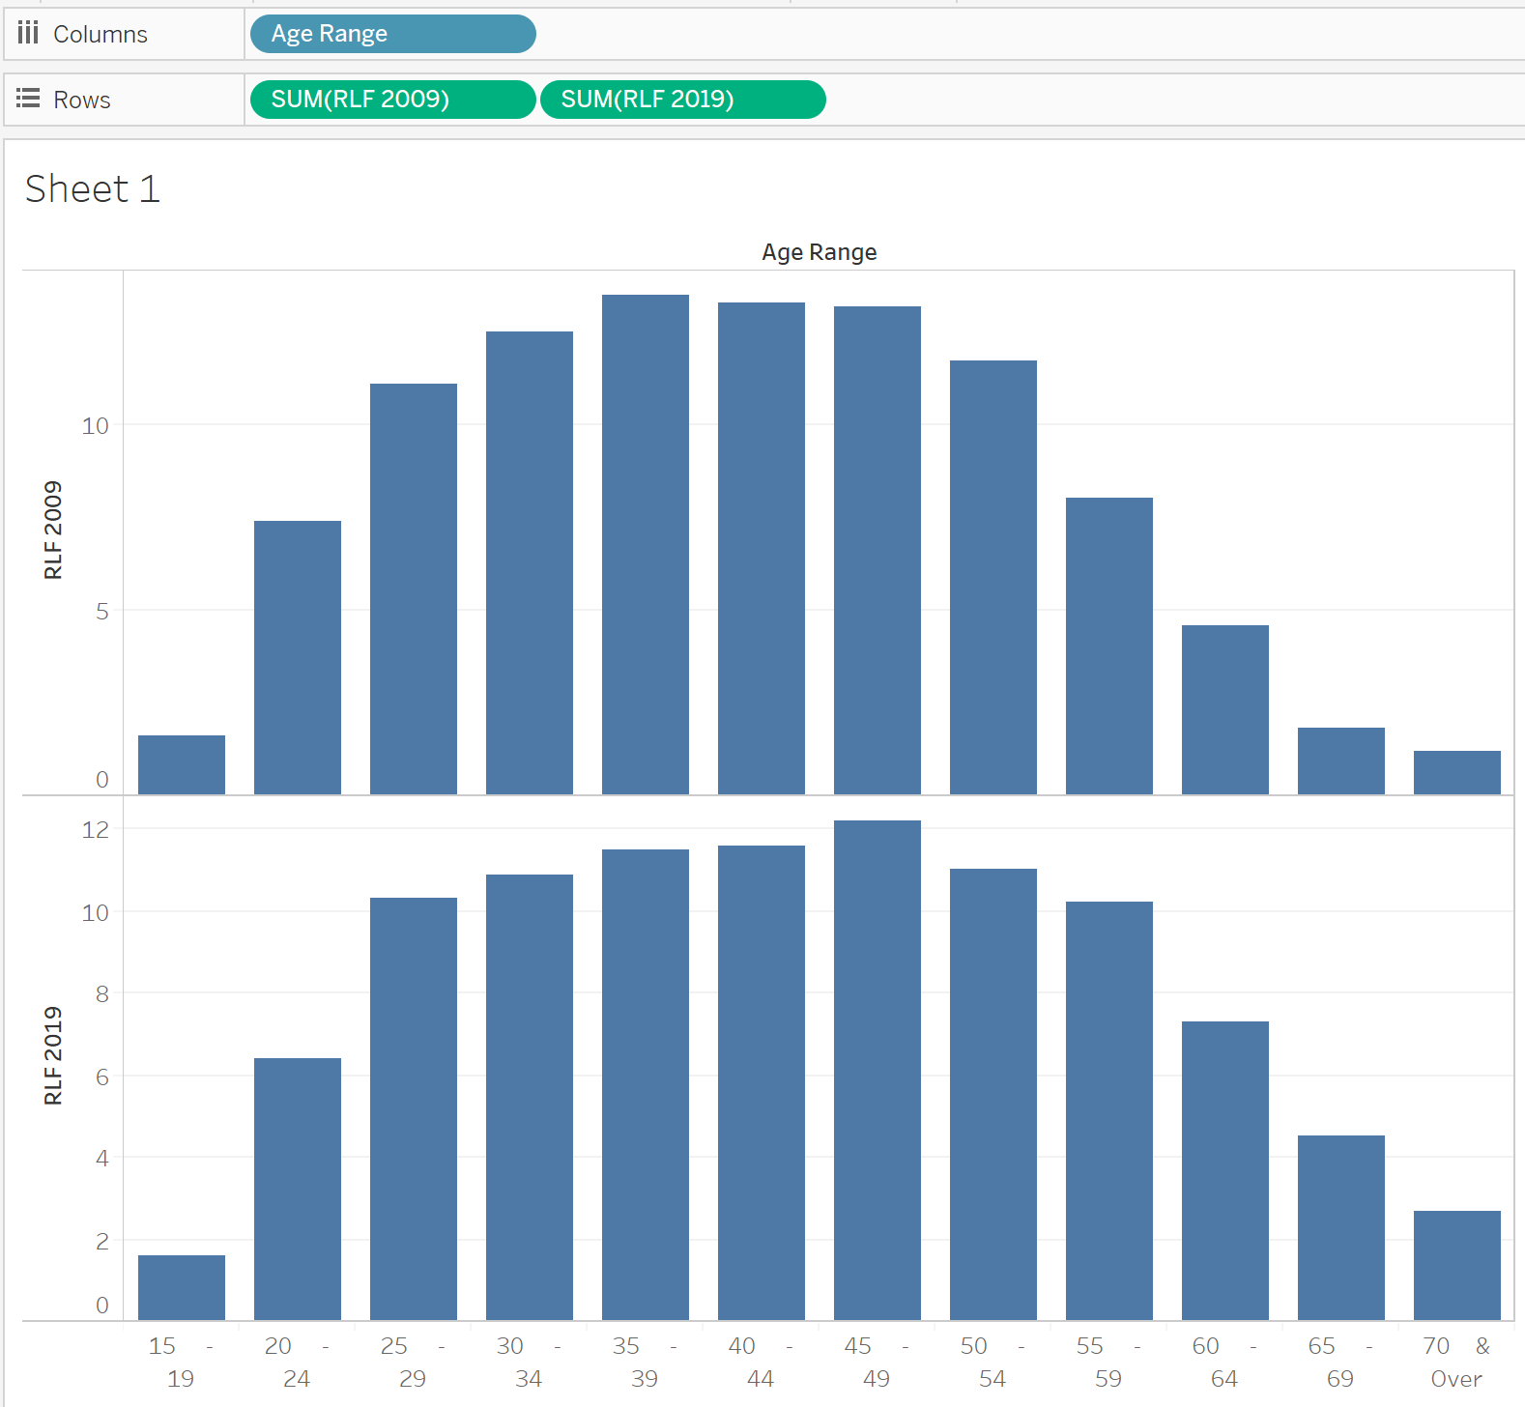
Dual / synchronise axis

Slide 4
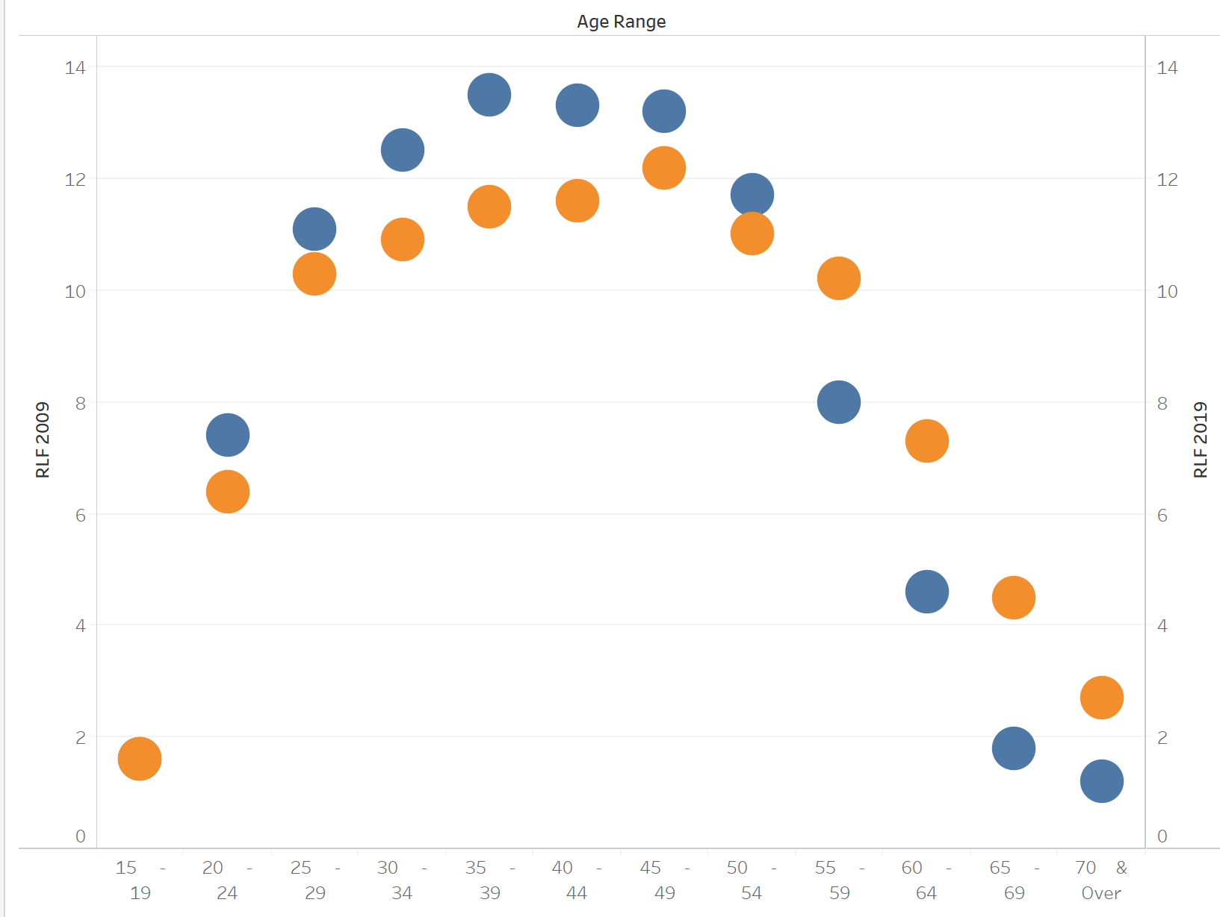
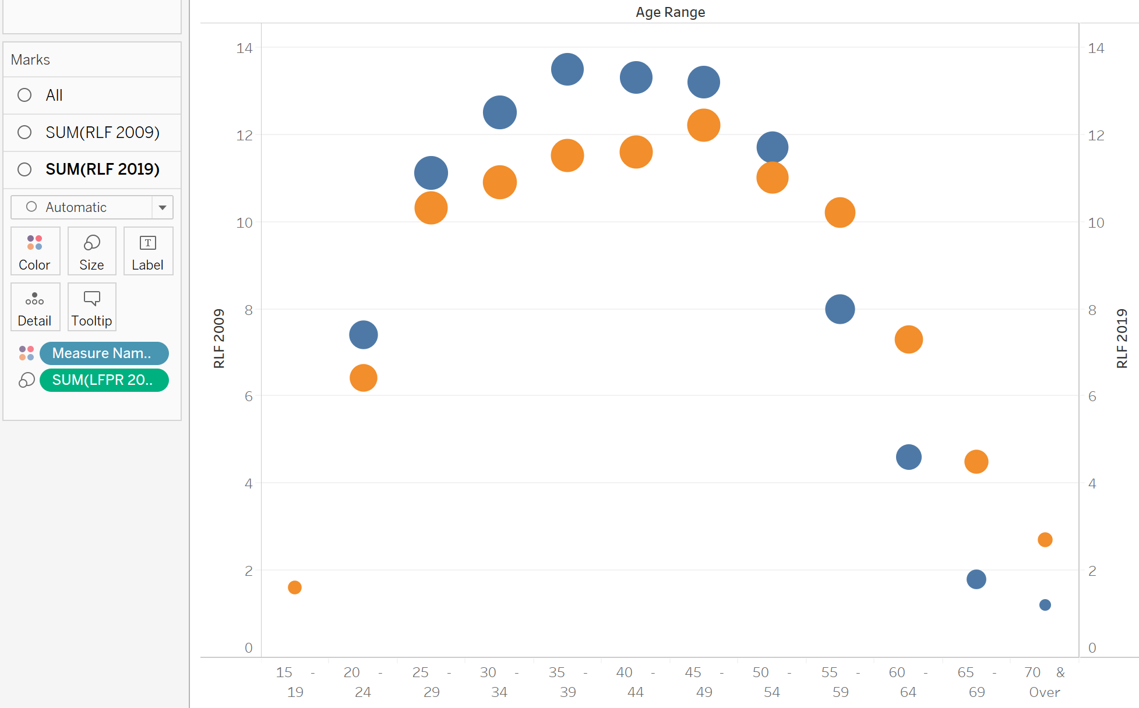
Rotate axis, fit width

Slide 5
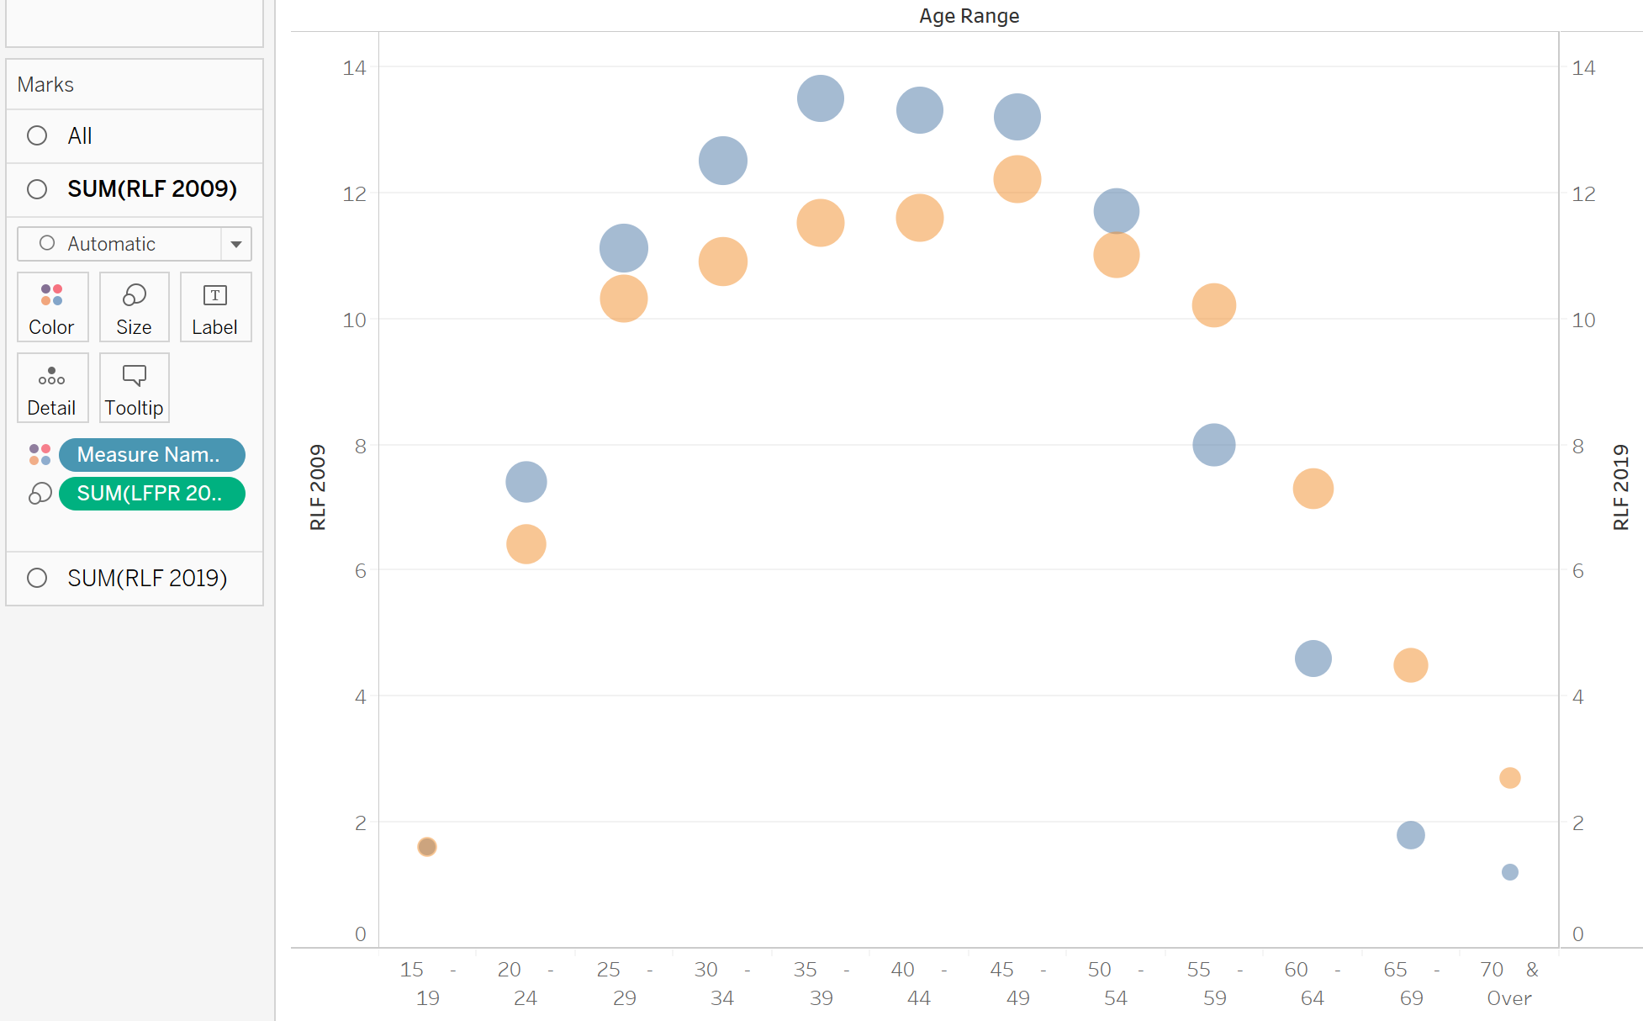
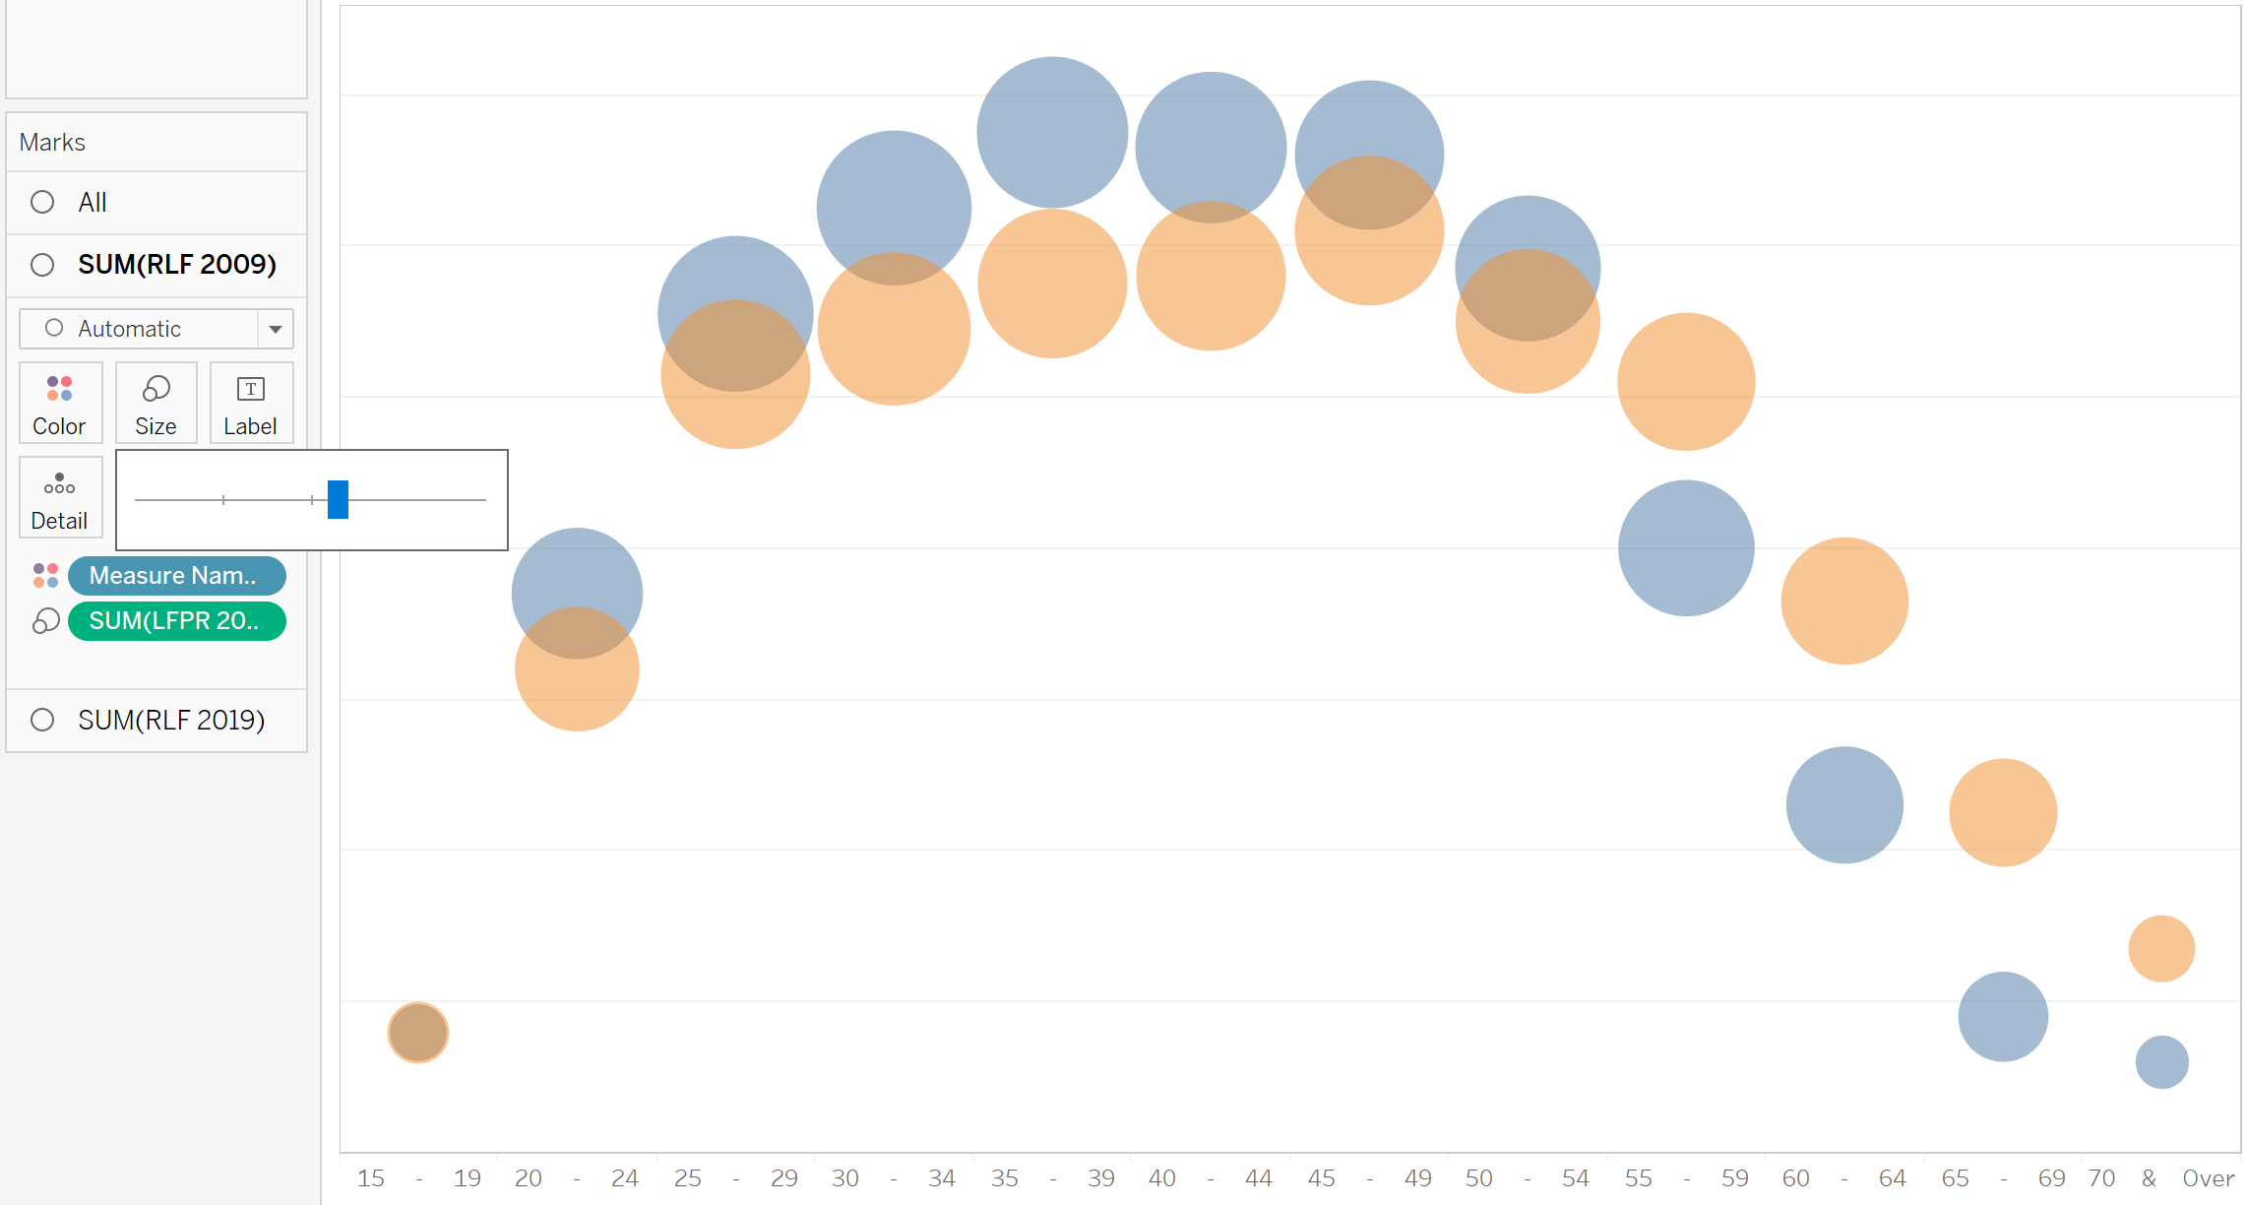
Opacity = 50%
Increase size
Hide headers

Slide 6
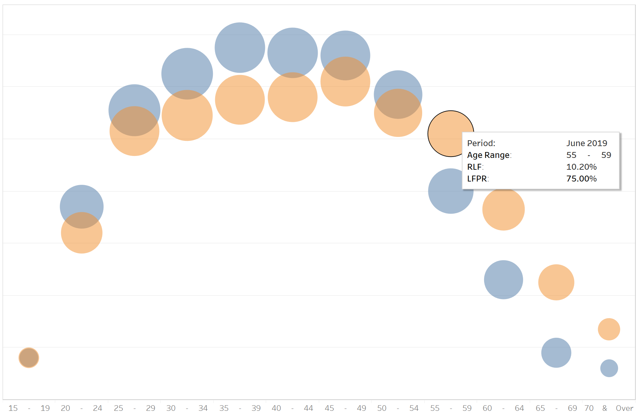
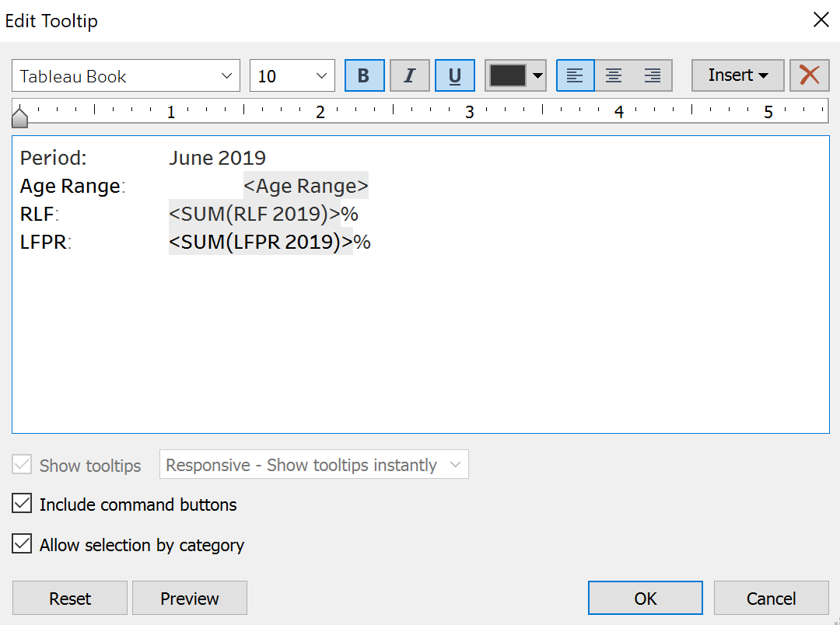

Slide 7
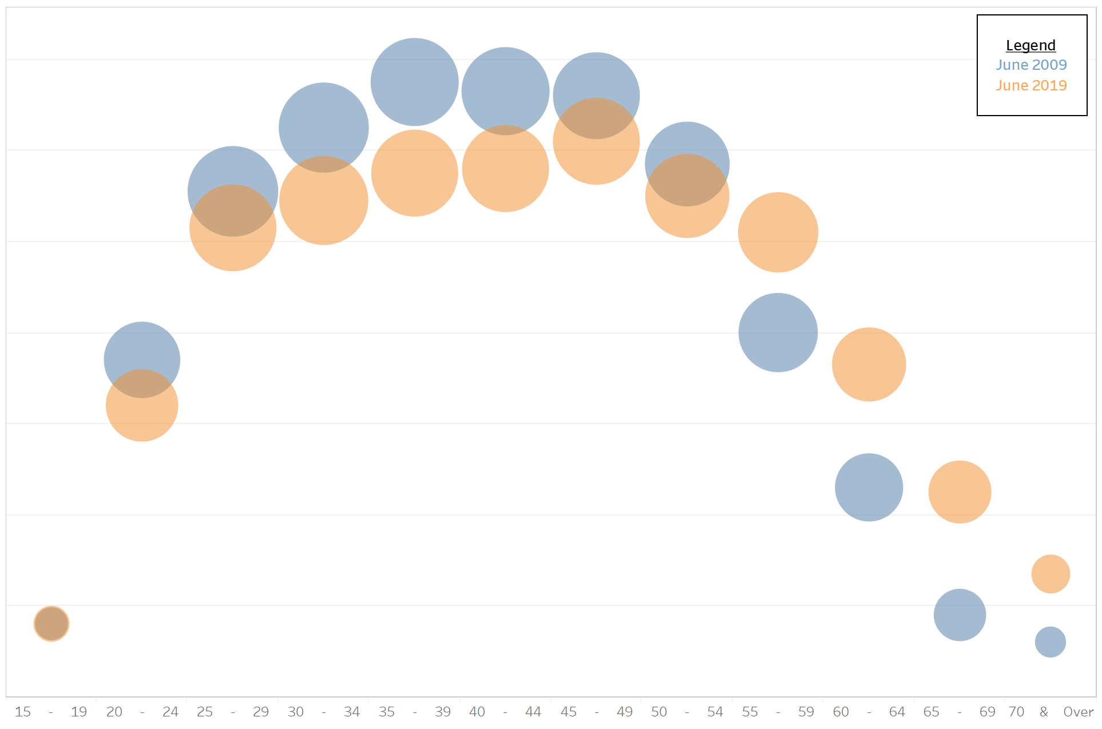
Add legend as annotation
Drag Age Range to Columns
Drag RLF2009 and RLF2019 to Rows
Click Text Table on Show Me
Hide headers
Drag Measure Names to Color

Slide 8
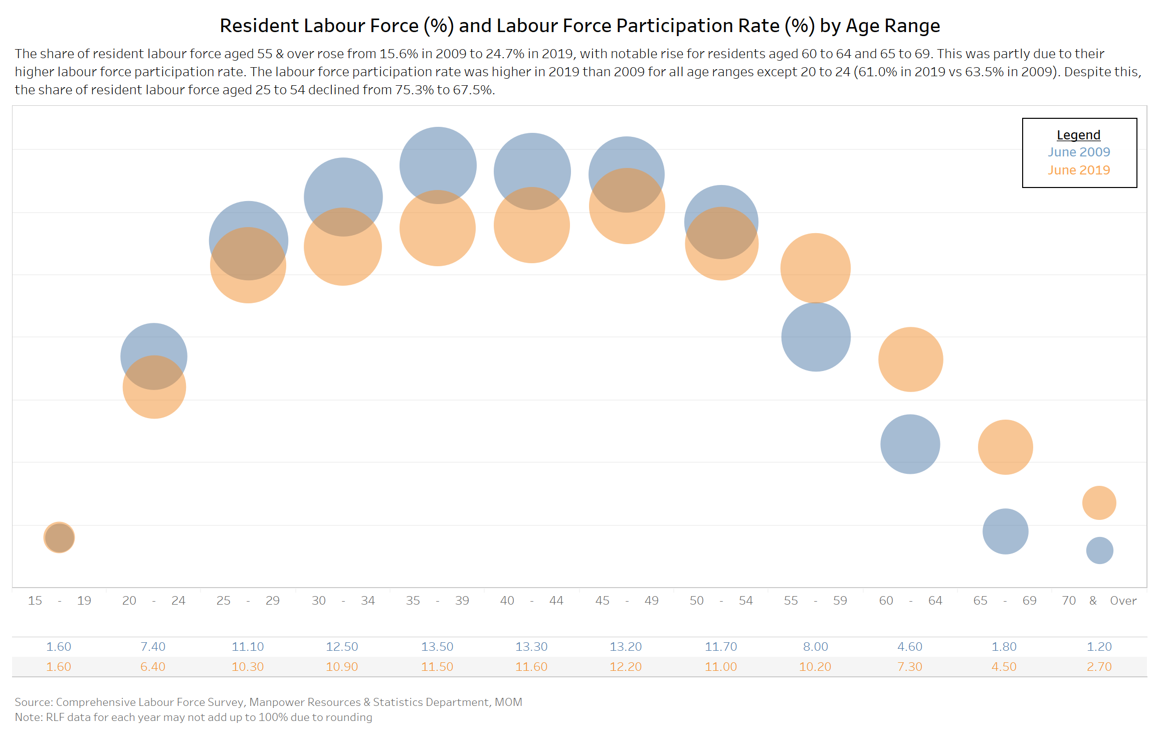
Add title, lead-in paragraph, source as text
Add dot chart
Add RLF data

Slide 9
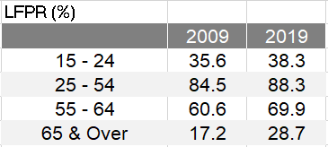
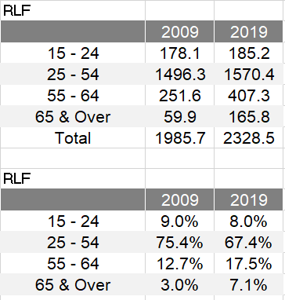
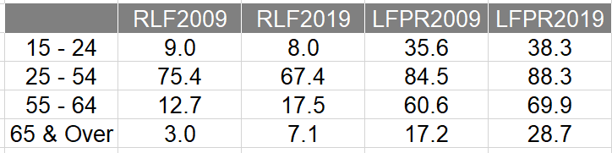
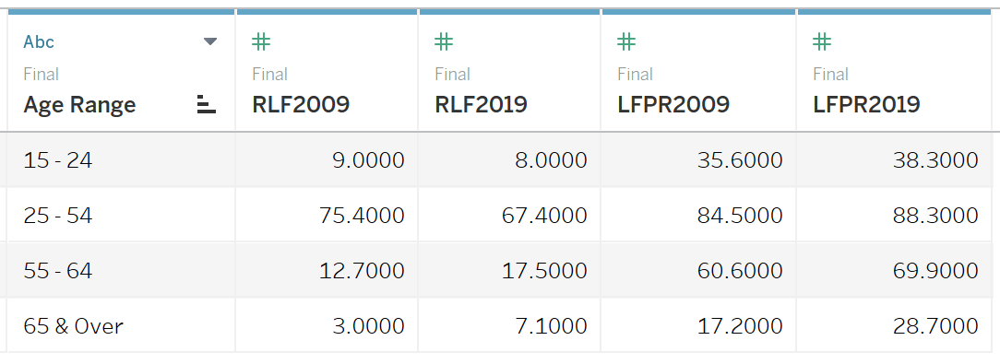

Slide 10
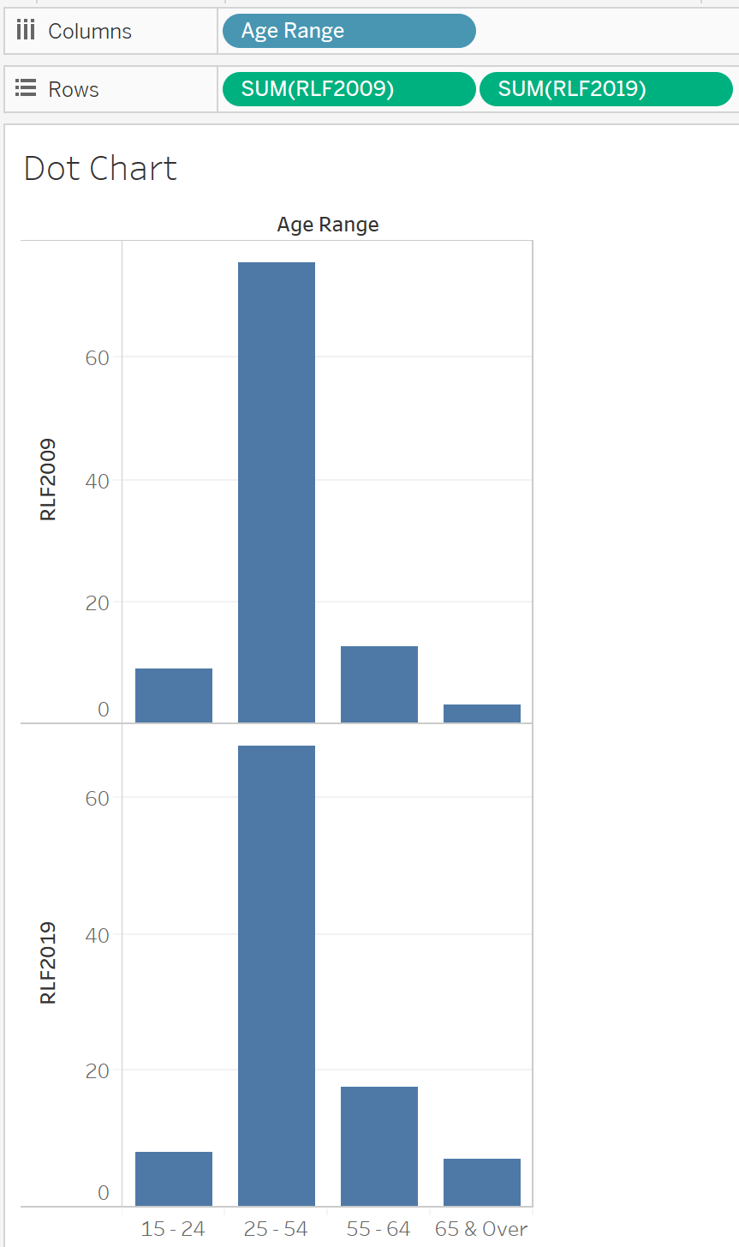
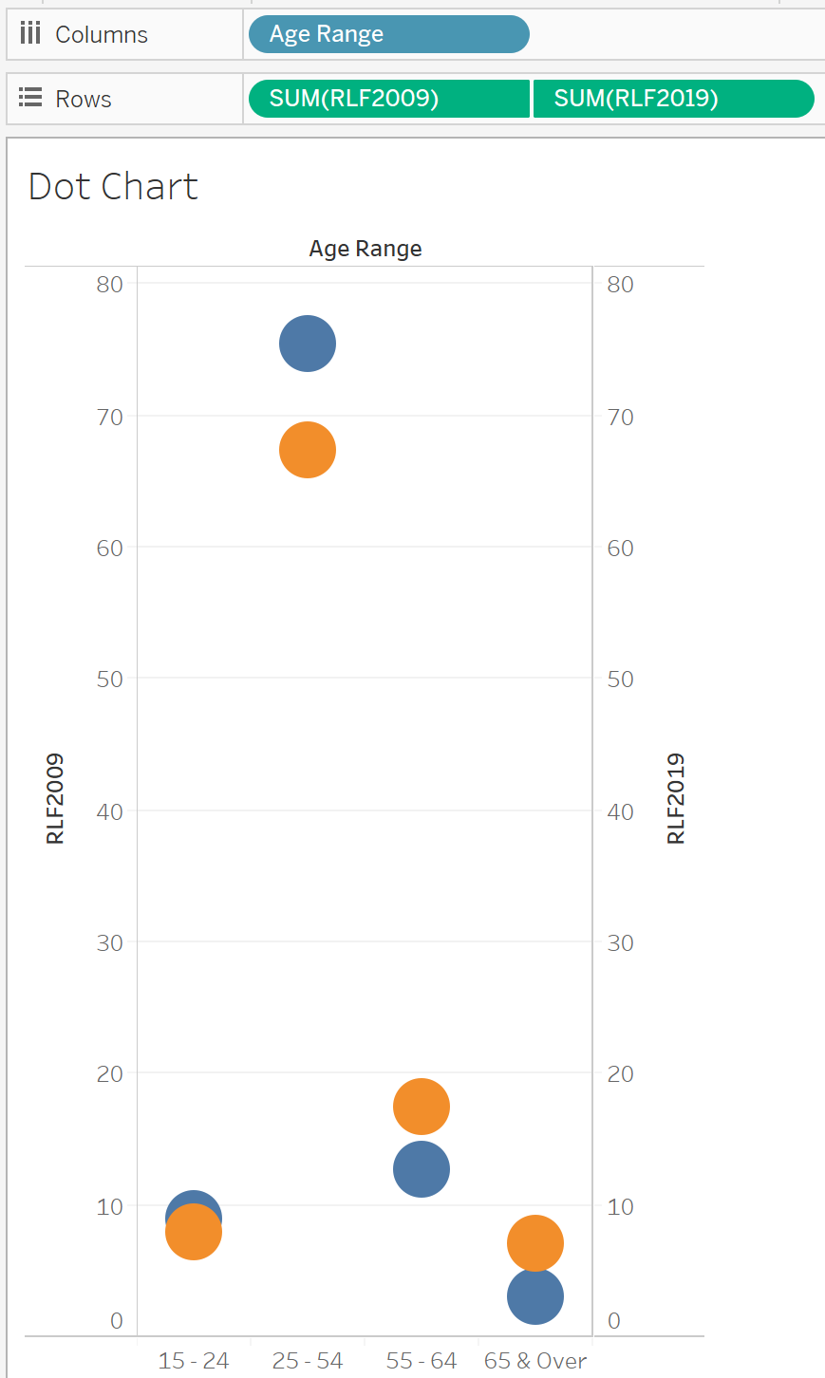

Slide 11
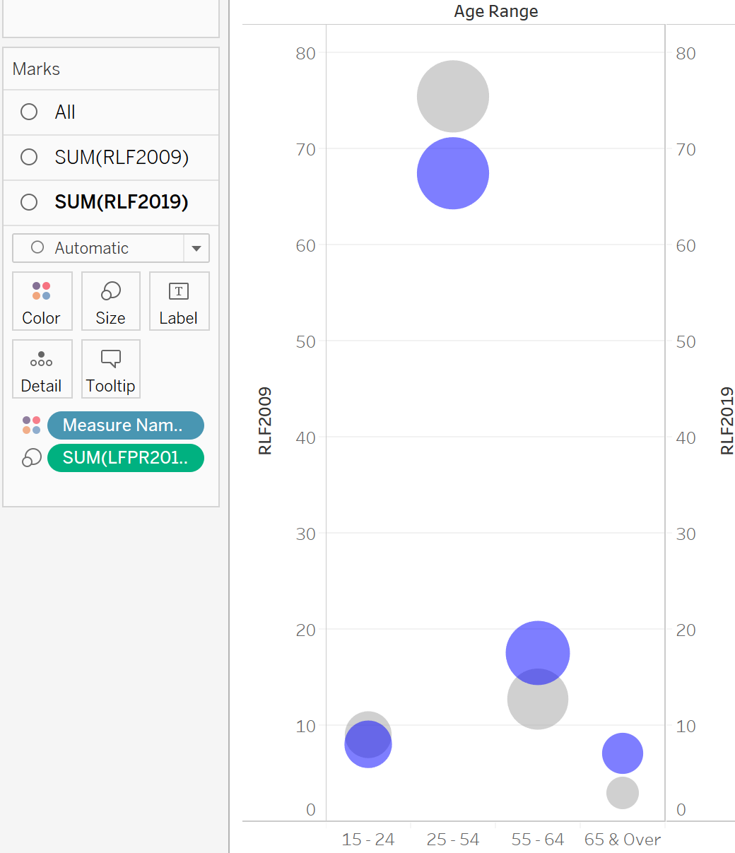
Opacity = 50%
Increase size
Change colour

Slide 12
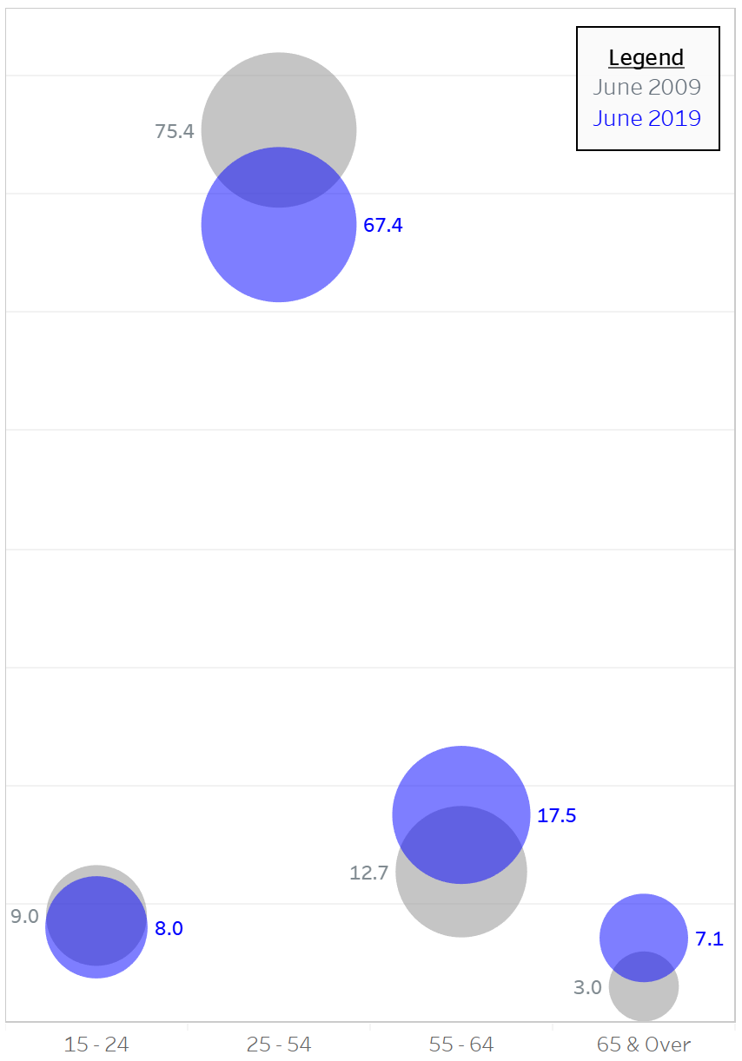

Drag Age Range to Columns
Drag LFPR2009 and LFPR2019 to Rows
Click Text Table on Show Me
Swap Rows and Columns
Hide field label for column and headers
Drag Measure Names to Colour
Change Colour
Hide field label for column and headers
Adjust dimensions of chart
RLF2009 and RLF2019 under Label, align/colour
Add legend as annotation

Slide 13
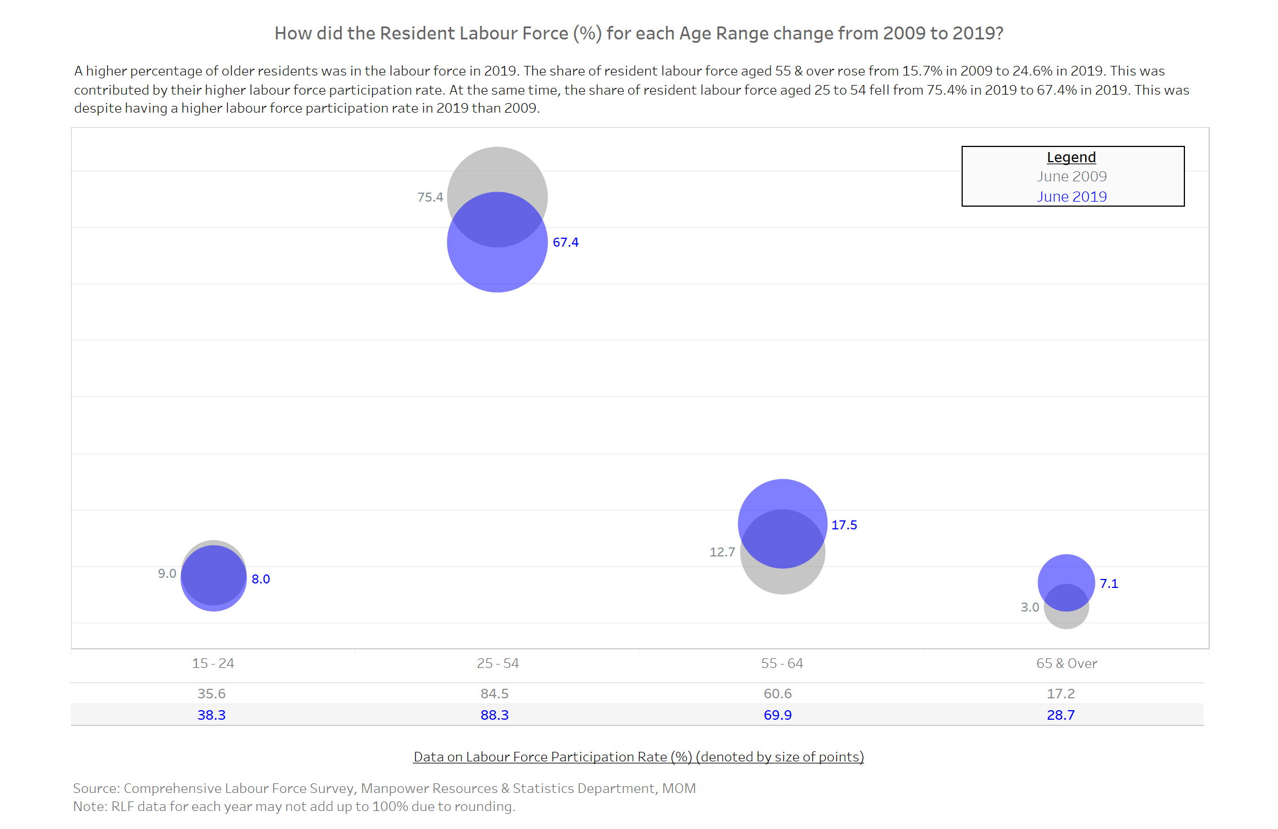
Add title, lead-in paragraph, source as text
Add dot chart
Add LFPR data
Add blank to adjust dashboard dimensions

